Slide 1

No Student Left Behind: Thanks to Data! ☺
Presented by: Christelle Younan & Ali Ali Institution: ZAKA ACADEMY Date: 3 MAY 2025

Slide 2
Kicking Things Off 🚀
Student dropout is a major educational challenge, especially in Portugal.
This project examines dropout causes and predictions for:
University students (median age: 19–20)
School students (median age: 17)
We combine machine learning and visual analytics to uncover key factors.

Slide 3
The Master Plan 🧠
Analyze real-world data from Portugal.
Identify the most impactful factors behind student dropouts.
Apply machine learning to predict risk.
Use Tableau to build dashboards for insights.
Recommend actionable strategies.

Slide 4

Meet the Datasets
University Dataset:
Predict students' dropout and academic success : Source: Kaggle
Students: 4424 (filtered: 3374 Portuguese, ages 18–25)
Variables: demographics, academic history, financial info
School Dataset:
Student Dropout Analysis and Prediction: Source: Kaggle
Students: 649 students (filtered: Portuguese, median age 17)
Variables: academic grades, performance indicators, support systems

Slide 5
Methodology
Data Cleaning
Exploratory Data Analysis
Filtering
Age: 18–25 (University) and Age : 17 (school)
Nationality: Portuguese
Machine Learning
Handled missing values, removed outliers, filtered by age and nationality.
Used correlation plots, boxplots, and distribution graphs
Converted categorical variables to factors and standardized numerical features.
Focused on variables like tuition status, parental qualifications, and academic performance
Applied five models: Logistic Regression, KNN, Naïve Bayes, Decision Tree, and Random Forest.
Trained on 80% of the data, tested on the remaining 20% to evaluate real-world performance.
Compared models using accuracy, sensitivity, and confusion matrices.

Slide 6

University Case: ML Results & Insights
Best Model:
Why Random Forest?
Handles non-linear relationships
Robust against overfitting
Provides feature importance for interpretability
Inputs (Features):
Demographics: Age, Gender, Nationality
Academic performance: Units enrolled, approved, grades
Support indicators: Debtor status, Scholarship, Special needs
Macroeconomic: Unemployment rate, GDP
Output:
How It Works:
Combines predictions of many decision trees (majority vote)
Improves accuracy and helps explain dropout behavior
Model Performance:
Accuracy: 78.03%
Sensitivity:
Dropout: 75.7%
Enrolled: 70.6%
Graduate: 88.9%
Main Takeaway:
Strong predictive and interpretive power
Helps universities proactively support at-risk students
Student status (Dropout, Enrolled, Graduate)
Random Forest

Slide 7
School Case: ML Results & Insights
Best Model:
Handles non-linear relationships
Robust against overfitting
Provides feature importance for interpretability
Inputs (Features):
Academic performance: Number of failures, number of absences, study time
Output:
Combines predictions of many decision trees (majority vote)
Improves accuracy and helps explain dropout behavior
Model Performance: (school)
Accuracy: 100%
Sensitivity:
Dropout: 15.4 %
Why Random Forest?
Random Forest
Lifestyle: Going out, free time, alcohol consumption
Demographic information: mother’s occupation, father’s occupation, Guardian, Family relationship
How It Works:
Dropout rates
Graduate: 84.6%

Slide 8

Key Findings - University Students
📉 Dropout Rate: 11% of Portuguese university students in the filtered group dropped out significantly lower than original unfiltered rates.
💸 Financial Factors:
Debtors showed a notably higher dropout likelihood.
Students without debt were more likely to graduate.
Scholarship holders dropped out less frequently, supporting research that financial aid improves retention.
👨‍🎓 Gender Patterns:
Male students had a less dropout rate than females.
Females were more represented among graduates.
📚 Academic Performance:
Students with fewer approved curricular units and lower grades (in both semesters) were much more likely to drop out.
Performance in the 1st semester was especially predictive of future risk.

Slide 9
Key Findings – School Students
🎓Dropout rates:
15% of school students tend to drop out of school. That is due to several factors:
📚Academic Performance:
Students with high number of failures and absences have shown higher rates of dropouts.
All students who dropped out performed poorly in their first semester.
👨‍👩‍👧‍👦Demographics:
Students with a stay-at-home parent tend to dropout more than others.
Students who live with a guardian other than a parent or have bad family relationships also have higher chances of dropping out.
🍻Lifestyle:
Students who have increased alcohol consumption tend to drop out more often.

Slide 10
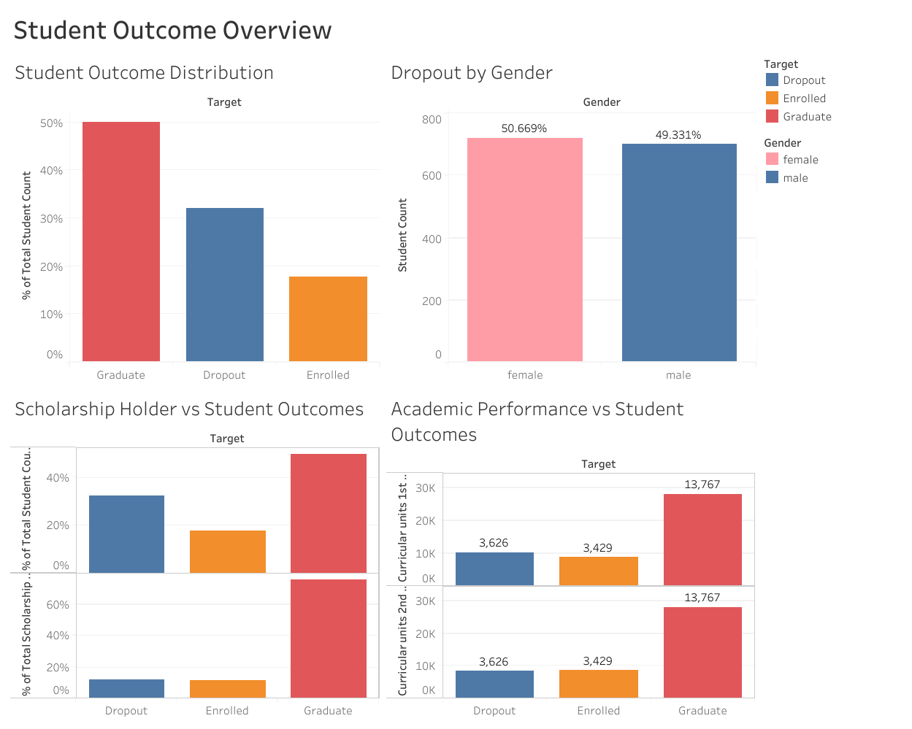
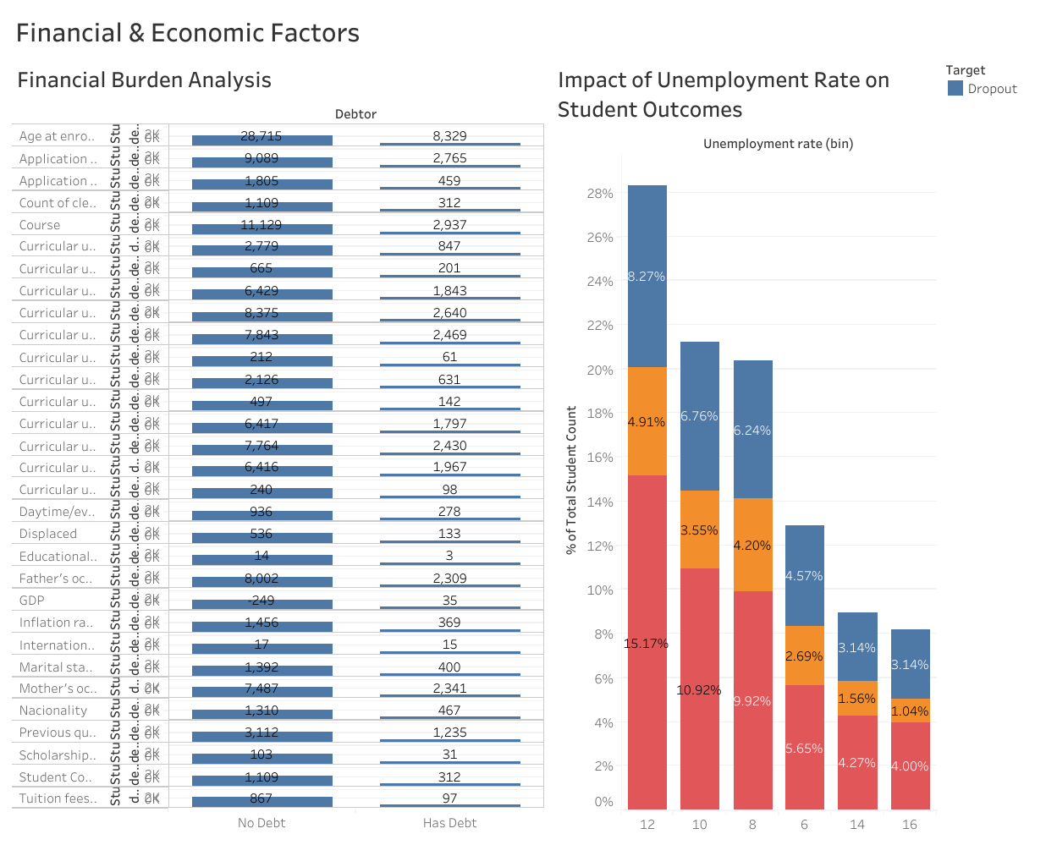
Visual Dashboards
Academic performance, financial burden, and unemployment rates are key drivers of student outcomes.

Slide 11
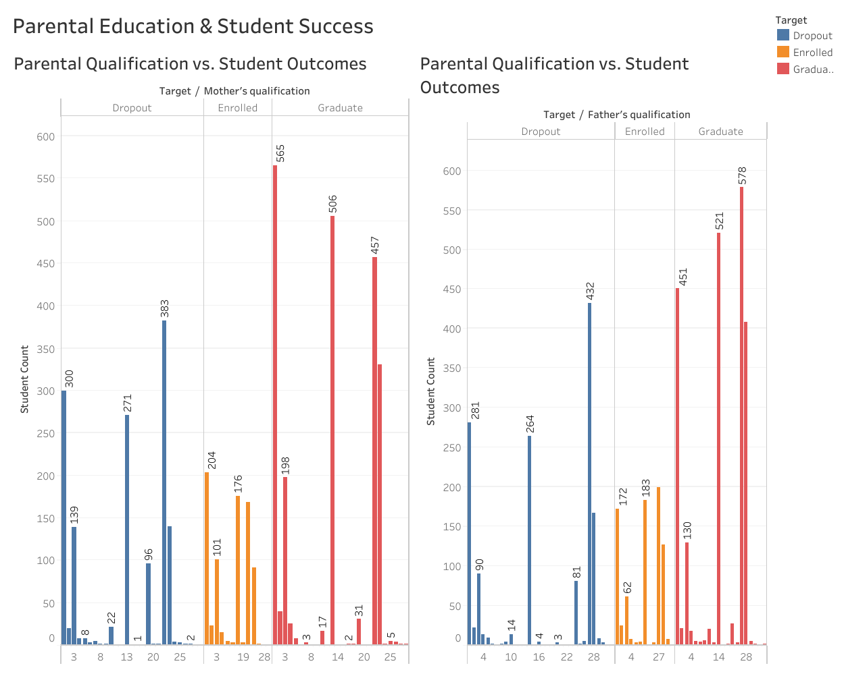
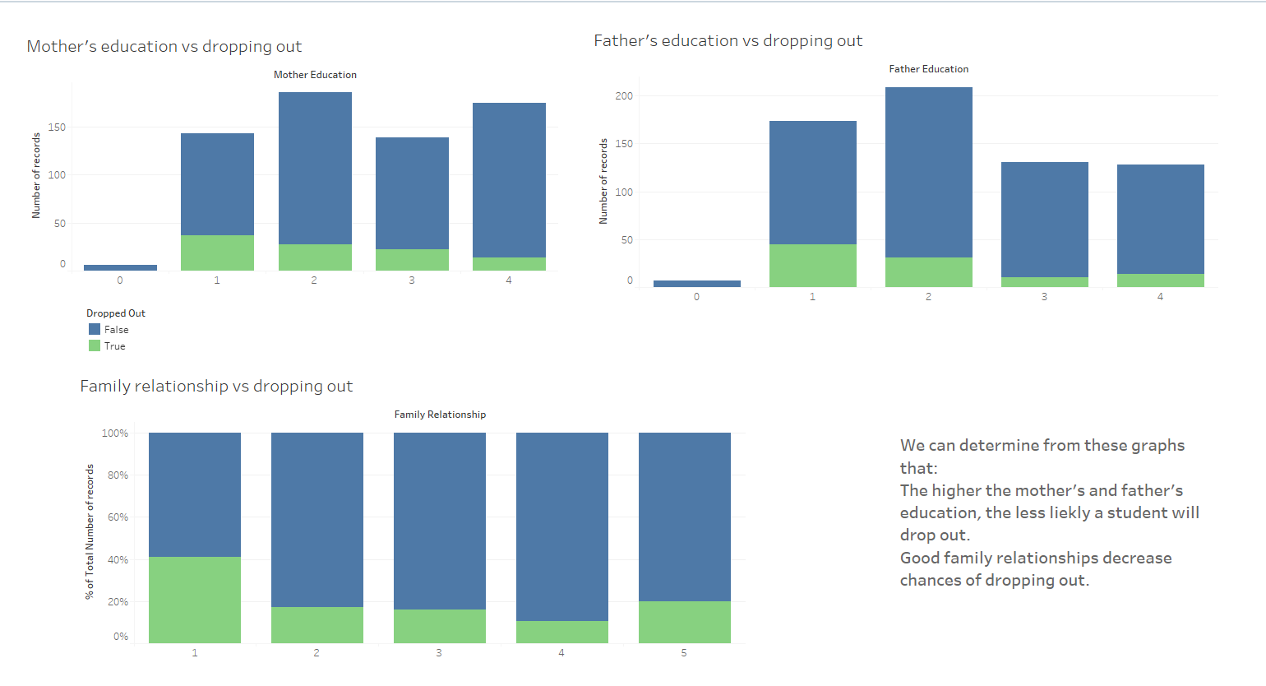
Higher parental qualifications are associated with increased student graduation rates and lower dropout rates in both cases university and school.

Slide 12

The ‘‘Don’t Panic, Just Do This Survival Kit’’ List
For University Students: 📌 Create early warning systems according to debt and grades. 📌 Expand financial aid and scholarship opportunities. 📌 Establish academic and psychosocial support facilities.
For School Students: 📌 Family counseling services are offered at neighborhood community centers or schools. 📌 To create a steady support network, pair students without parent guardians with committed mentors or "school buddies." 📌 Lead peer or local professional-led school-based substance abuse awareness campaigns.

Slide 13
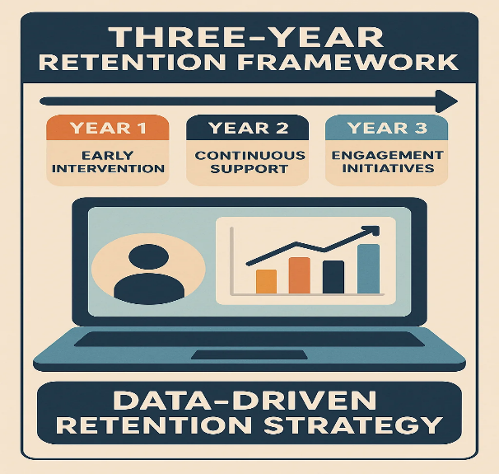
First Year: Proactive Recognition:
Put in place Early Alert Systems that identify at-risk pupils based on demographic, economical, and academic characteristics utilizing predictive models .
Institutional Screening: Consistent audits to identify deteriorating academic performance and financial risk.
Second Year: Specific Actions
Tailored Academic Support: Peer-assisted learning and tutoring for kids who perform poorly in classes.
Debt Relief & Financial Aid Navigation: Helping students who are in debt find assistance or restructure their payments.
Mentorship Programs: To increase motivation and a sense of community, pair at-risk students with faculty advisors or senior peers.
Third Year: Systemic Change and Policy
Increase Grant Accessibility: Update the requirements for scholarships to include more at-risk and middle-class students.
Require Data Tracking: For retention analytics, mandate that colleges keep complete, anonymized student datasets.
Regional Assistance Centers: To offer financial and educational support, set up community-based outreach centers in areas with high dropout rates.
The Long Game: Stay. Learn. Graduate

Slide 14
Final Thoughts Before We Drop Out :p
The Real Dropout Issue? Lack of guidance.
Many students drop out simply because they: ❌ Chose the wrong major ❌ Followed the crowd ❌ Had no clear direction
?And guess what? That starts way before they enter university.
Find Your Path, No Map Required !
Being a high school student with no roadmap can feel like:
“Pick a major… any major… just make it marketable!” 😰
But passion > popularity.
When students choose blindly, motivation drops and dropouts rise.

Slide 15
WHAT CAN WE DO? Here’s the Plan (Spoiler: It’s Good)
A-Start Early, Start Smart
A student-centered career advisory program is key especially for seniors.
When students explore industries, career paths, and real-world applications early on, they make better choices aligned with their passions and goals.
Our research? Clear. Students aiming for higher education are less likely to drop out.
B- Let’s Offer More Than One Route
Not every student dreams of a traditional university degree. Some thrive in:
Community colleges
Blue-collar careers
Entrepreneurship
That’s why guidance programs must be inclusive of alternative paths too.

Slide 16

🏆 In a Nutshell, Career Guidance Helps...
✅ Reduce anxiety about the future ✅ Align academic choices with passions ✅ Explore diverse career paths ✅ Lower college dropout rates ✅ Build purpose-driven, long-term goals

Slide 17
References
Harvard Kennedy School. (n.d.). Addressing the completion challenge in Portuguese higher education. Retrieved from https://www.hks.harvard.edu/
Macau Business. (2022, March 7). Portugal: Only very poor get scholarships so many students give up study. Retrieved from https://www.macaubusiness.com/portugal-only-very-poor-get-scholarships-so-many-students-give-up-study/
Moreira da Silva, D. E., Solteiro Pires, E. J., Reis, A., de Moura Oliveira, P. B., & Barroso, J. (2022). Forecasting students dropout: A UTAD University study. Future Internet, 14(3), 76. https://doi.org/10.3390/fi14030076
ResearchGate. (n.d.). Higher education dropout in northern Portugal. Retrieved from https://www.researchgate.net/
European Commission. (2024). Education and Training Monitor 2024. EUR-Lex. Retrieved from https://eur-lex.europa.eu/
Organisation for Economic Co-operation and Development. (n.d.). Education at a glance. Retrieved from https://www.oecd.org/education/education-at-a-glance/

Slide 18

Thank You!

